Slide 1
Project Descriptions
SoSe-21 Machine Learning-Based Control of Dynamical Systems
Chris Adriano
Sona Ghahremani
He Xu
Prof. Dr. Holger Giese

Slide 2
Project Plan

Slide 3
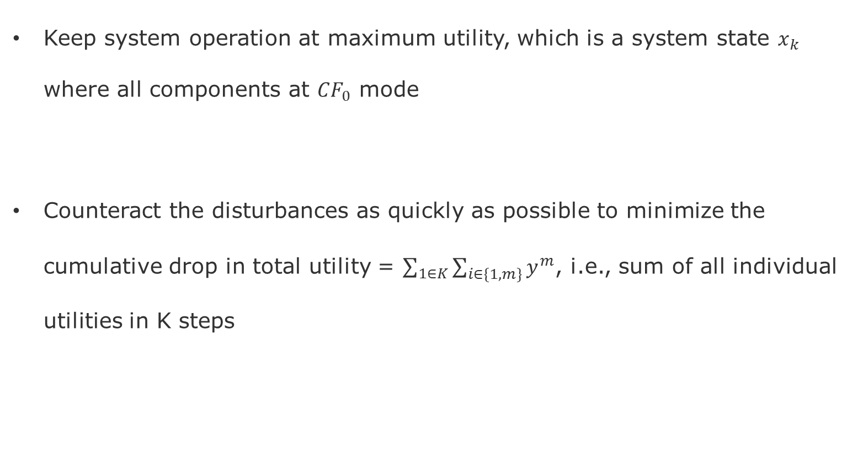
Goals
Keep system operation at maximum utility, which is a system state $x_{k}$ where all components at $CF_{0}$ mode
Counteract the disturbances as quickly as possible to minimize the cumulative drop in total utility = $\sum_{1∈K}{\sum_{i∈\{1,m\}}{y^{m}}}$, i.e., sum of all individual utilities in K steps

Slide 4
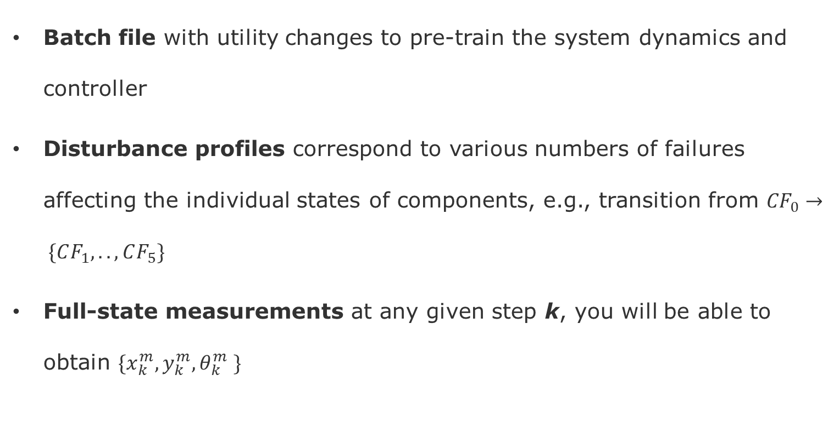
Inputs
Batch file with utility changes to pre-train the system dynamics and controller
Disturbance profiles correspond to various numbers of failures affecting the individual states of components, e.g., transition from ${CF}_{0}→ \{CF_{1},.., CF_{5}\}$
Full-state measurements at any given step k, you will be able to obtain $\{x_{k}^{m},y_{k}^{m}, θ_{k}^{m} \}$

Slide 5
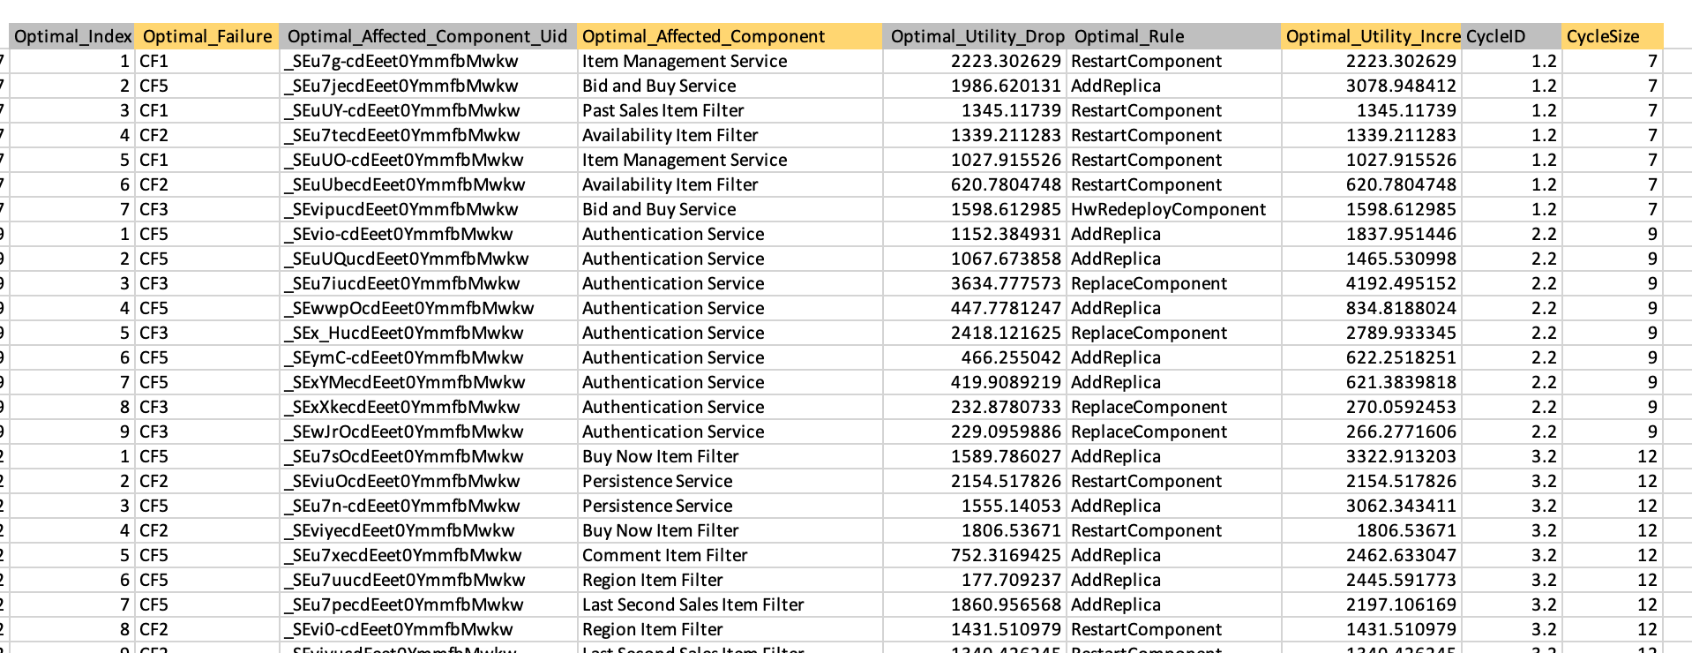
Data Used for the Implementation

Slide 6
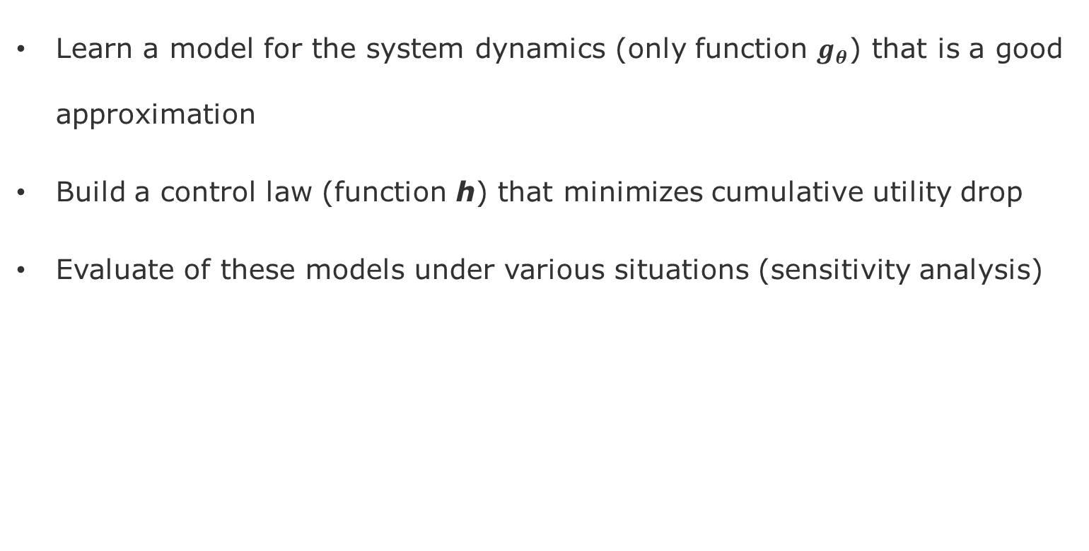
Deliverables
Learn a model for the system dynamics (only function $g_{θ}$) that is a good approximation
Build a control law (function h) that minimizes cumulative utility drop
Evaluate of these models under various situations (sensitivity analysis)

Slide 7
Project-1 - Tasks
Environment Setup
Execute mRubis system simulator Java-Java
Execute the integration Python-Java
System Identification (train a model of mRubis system)
Choose a Machine Learning algorithm)
Train a prior model with batch data
Controller Synthesis
Sample the sensors
Learn the control model/law
choose which actuators to execute and in which order
Evaluation
Level of disturbances
Sensor sampling frequency
Actuation frequency
Rationale of the Plan
Tasks 2 and 3 will rotate among you three across the projects, so everyone can work more deeply on System Identification and Controller Synthesis
However, everyone will run a separate evaluation and present their findings. This way, all of you have a chance to reflect upon the methods and architecture

Slide 8
Roadmap
Project-1
Full-State Measurements
Linear and Non-Linear System Dynamics
Project-2
Partial State Measurements
Latent Models (Failure Masking)
Project-3
Transfer-Learning of System Dynamics
Adaptive Control
Project-4
Reinforcement Learning Control
Model-Based, Model-Free versus ML-Control

Slide 9
Roadmap – Individual Projects
Project-1 Full-State Measurements
Linear and Non-Linear System Dynamics
Non-Stationary Environment
Environment Integration
Project-3 Transfer Learning (Jakob)
How to use the models from Project-1 as a prior for learning a second shop?
What are the gains in training cost and control performance?
Environment Choice
Python RL Agents Implementations
Project-2 Partial State Measurements (Paul)
Latent Models (Failure Masking)
What is the overhead cost of learning the latent model?
What is the performance penalty (accuracy/reward)?
Project-4 Reinforcement Learning Control (Kim)
Reinforcement Learning Control
How the Model-Based Model-Free versus ML-Control (project-1) compare w.r.t. to:
Training overhead
Execution overhead (prediction/control)

Slide 10
End

